Slide 1

Classification of Speech/Music Using Multivariate Features
- Shubhanshu Yadav
Fundamentals of speaker recognition

Slide 2
Motivation
Audio Classification plays an important role in understanding the semantic content of the audio data.
An automated audio classification system classifying the content into speech, music and silence can be used for many purposes including but not limited to audio indexing, content based audio retrieval and online audio distribution.

Slide 3

Feature Extraction – MFCC
MFCCs are a widely used feature in audio and speech processing.
Mel-frequency cepstral coefficients (MFCC) is a parameter used in the discrimination due to the spectral difference between music and speech.
A commonly used formula to approximately reflect the relation between the Melfrequency and the physical frequency is given by:-
$M\left(f\right)=1125×\log_{10}(1+\frac{f}{700})$

Slide 4
Feature Extraction – Delta MFCC
Features for classification system need to be channel invariant.
Therefore, dynamic features reflecting change over time are required.
Delta Cepstral Features serves to solve that problem.

Slide 5

Feature Extraction – PSDev
Power Spectrum Deviation (PSDev) is computed as the standard deviation of the filter bank energies in each band.
PSDev can be found using :-
$P_{i}= \frac{1}{n−1}(\sum_{j=1}^{N}{{(E_{ij}−E_{i})}^{2}})$

Slide 6
Feature Extraction – RASTA-PLP
A technique that applies a band-pass filter to the energy in each frequency subband in order to smooth over short-term noise variations and to remove any constant offset resulting from static spectral coloration in the speech channel.

Slide 7
Universal Background Model (UBM) Adaptation
Universal background model (UBM) classification is a technique that can be utilized when there is an extremely large amount of available but unlabeled data. Features from this unlabeled data are used to boost the performance of traditional classifiers.
UBM adaptation and testing consists of several discrete steps. The steps themselves are:
1. Background model creation
2. Background model adaptation to a specific ensemble

Slide 8
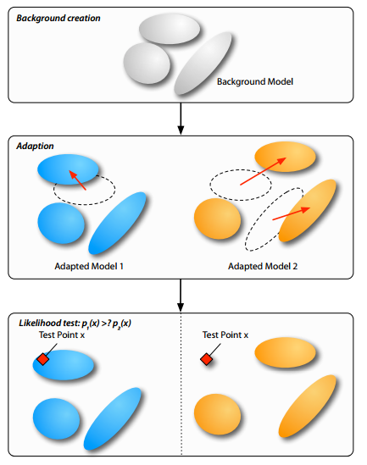
Universal Background Model (UBM) Adaptation - Continued

Slide 9
Universal Background Model (UBM) Adaptation - Continued
Advantage to using UBM adaptation as opposed to training an individual Gaussian mixture model (GMM) for each class is that it is assumed that the UBM is already well-trained. GMMs often fit data sub-optimally, but the well-trained parameters of the UBM provide a good starting point for additional models built on top of it.

Slide 10
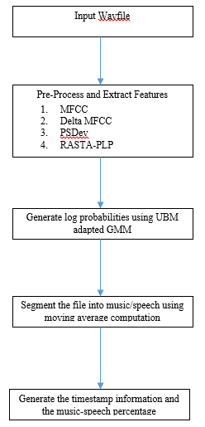
Implementation

Slide 11
Results
File Type | Classification Percentage
Speech | 81.82%
Music with no vocals | 66%
Music with vocals | 91.8%

Slide 12
Conclusion
Moving Average Computation – 5 Frames > 3 Frames.
Performed another implementation with BIC. The results obtained from that closely track the proposed implementation.

Slide 13
THANK YOU!

